Slide 1
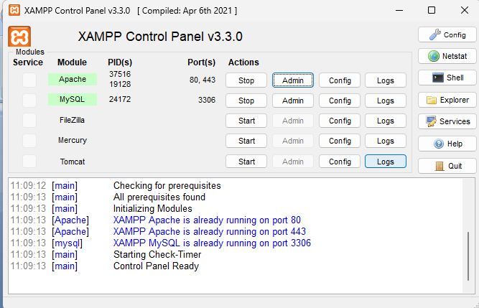
How to Create a Table in MySQL Using XAMPP

Slide 2
Step 1: Open XAMPP Control Panel
• Start the XAMPP Control Panel on your computer.
• Ensure that both Apache and MySQL modules are running.
• Click 'Start' next to Apache and MySQL if they are not already running.

Slide 3
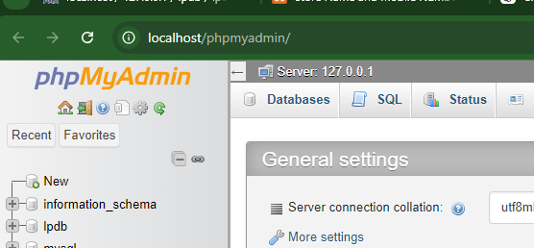
Step 2: Open phpMyAdmin
• Open your browser and go to http://localhost/phpmyadmin.
• This will open the phpMyAdmin dashboard, where you can manage MySQL databases.

Slide 4
Step 3: Select a Database
• In the phpMyAdmin interface, you will see a list of databases on the left panel.
• Select the database where you want to create a new table. If you don't have one, you can create it using the 'New' button.

Slide 5
Step 4: Create a New Table
• After selecting a database, go to the 'Structure' tab.
• You will see an option to 'Create Table.' Enter the name of the table and the number of columns, then click 'Go.'

Slide 6
Step 5: Define Table Columns
In the next screen, you'll be prompted to define the columns of the table.
Specify the column names, data types (e.g., INT, VARCHAR), and other attributes such as length, primary key, and auto-increment.

Slide 7
Step 6: Save the Table
• After defining the columns and their properties, scroll down and click 'Save.'
• Your table will be created, and you can view it under the 'Structure' tab.

Slide 8
Setting up MySQL user Account
1)
CREATE USER 'username'@'localhost' IDENTIFIED BY 'password';
GRANT ALL PRIVILEGES ON myDB.* TO 'username'@'localhost';
FLUSH PRIVILEGES
2)
<?php
// Database configuration
$servername = "localhost"; // MySQL host (e.g., localhost)
$username = "root"; // MySQL username
$password = ""; // MySQL password (empty if using default setup)
$dbname = "lpdb"; // The name of the database
$conn = new mysqli($servername, $username, $password, $dbname);

Slide 9
Form to MySQL
<!DOCTYPE html>
<html>
<head>
<title>Store Name and Mobile Number</title>
</head>
<body>
<h2>Enter your name and mobile number</h2>
<form method="POST" action="">
<label for="name">Name:</label><br>
<input type="text" id="name" name="name" required><br><br>
<label for="mobile_number">Mobile Number:</label><br>
<input type="text" id="mobile_number" name="mobile_number" required><br><br>
<input type="submit" value="Submit">
</form>
</body>
</html>
<?php
// assumed: database, table created as database: lpdb, user: lph, pswd: csbs
$conn = new mysqli("localhost","lph","csbs","lpdb");
if ($conn->connect_error) {
die("Connection failed: " . $conn->connect_error);
}
// Insert data if form is submitted
if ($_SERVER["REQUEST_METHOD"] == "POST") {
$name = $_POST['name'];
$mobile_number = $_POST['mobile_number'];
// Prepare SQL to insert data
$sql = "INSERT INTO lptbl (name, mobileno) VALUES ('$name', '$mobile_number')";
if ($conn->query($sql) === TRUE) {
echo "New record created successfully";
} else {
echo "Error: " . $sql . "<br>" . $conn->error;
}
}
// Close connection
$conn->close();
?>

Slide 10
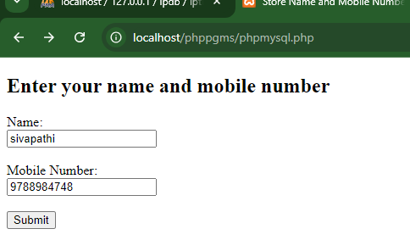
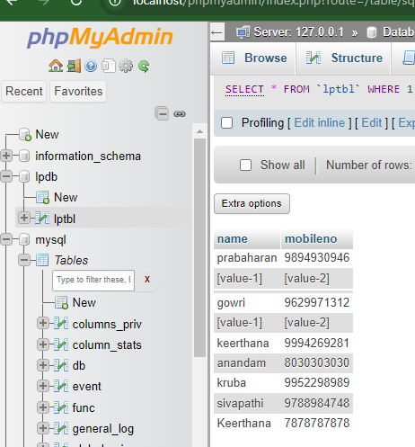
output

Slide 11
Retrieve from table
<?php
// Database connection details
$host = 'localhost'; // or 127.0.0.1
$dbname = 'lpdb';
$username = 'lph'; // your MySQL username
$password = 'csbs'; // your MySQL password // Create connection
$conn = new mysqli($host, $username, $password, $dbname);
// Check connection
if ($conn->connect_error) {
die("Connection failed: " . $conn->connect_error);
} // SQL query to fetch name and mobile number
$sql = "SELECT name, mobileno FROM lptbl";
$result = $conn->query($sql);

Slide 12
// Check if there are results and display them in a form
if ($result->num_rows > 0) {
// Output data of each row in a form with textboxes
while($row = $result->fetch_assoc()) {
echo '<form>';
echo 'Name: <input type="text" name="name" value="' . $row["name"] . '" readonly><br><br>';
echo 'Mobile Number: <input type="text" name="mobile" value="' . $row["mobileno"] . '" readonly><br><br>';
echo '</form>';
}
} else {
echo "0 results";
}
// Close connection
$conn->close();
?>

Slide 13
Redirection
If login credentials are valid then page is redirected to registration.php
if ($password==$row['password'])
{$_SESSION['username'] = $username;
header("Location: registration.php");
exit();
}

Slide 14
exercise
Create a Database user_system with table login table and registration table.
insert username and password in login table
Create a login.php page to validate the username and password
If validation successful then redirect to registration.php page
Else show invalid user
Valid user can register their details in the registration form
Insert details into the registration table

Slide 15
SQL :
CREATE DATABASE user_system;
USE user_system;
-- Create login_table to store username and password
CREATE TABLE login_table (
id INT(6) UNSIGNED AUTO_INCREMENT PRIMARY KEY,
username VARCHAR(50) NOT NULL,
password VARCHAR(255) NOT NULL
);
-- Create register table to store user details
CREATE TABLE register (
id INT(6) UNSIGNED AUTO_INCREMENT PRIMARY KEY,
fullname VARCHAR(100) NOT NULL,
email VARCHAR(100) NOT NULL,
phone VARCHAR(20) NOT NULL
);

Slide 16
Login.php
<?php
session_start();
$servername = "localhost";
$username = "root"; // Your MySQL username
$password = ""; // Your MySQL password
$dbname = "user_system";
$conn = new mysqli($servername, $username, $password, $dbname);
if ($conn->connect_error) {
die("Connection failed: " . $conn->connect_error);
}
if ($_SERVER["REQUEST_METHOD"] == "POST") {
$username = $_POST['username'];
$password = $_POST['password'];
$sql = "SELECT * FROM login_table WHERE username = '$username'";
$result = $conn->query($sql);

Slide 17
Login.php
if ($result->num_rows > 0) {
$row = $result->fetch_assoc();
//if (password_verify($password, $row['password'])) {
if ($password==$row['password'])
{$_SESSION['username'] = $username;
header("Location: registration.php");
exit();
} else {
echo "Invalid password!";
}
} else {
echo "Invalid username!";
}
}
$conn->close();
?>
<!DOCTYPE html>
<html>
<head>
<title>Login Page</title>
</head>
<body>
<h2>Login</h2>
<form method="post" action="">
<label for="username">Username:</label>
<input type="text" name="username" required><br><br>
<label for="password">Password:</label>
<input type="password" name="password" required><br><br>
<input type="submit" value="Login">
</form>
</body>
</html>

Slide 18
Register.php
<?php
session_start();
if (!isset($_SESSION['username'])) {
header("Location: login.php");
exit(); }
$servername = "localhost";
$username = "root";
$password = "";
$dbname = "user_system";
$conn = new mysqli($servername, $username, $password, $dbname);
if ($conn->connect_error) {
die("Connection failed: " . $conn->connect_error);
}
if ($_SERVER["REQUEST_METHOD"] == "POST") {
$fullname = $_POST['fullname'];
$email = $_POST['email'];
$phone = $_POST['phone'];

Slide 19
Register.php
$sql = "INSERT INTO register (fullname, email, phone) VALUES ('$fullname', '$email', '$phone')";
if ($conn->query($sql) === TRUE) {
echo "Registration successful!";
} else {
echo "Error: " . $sql . "<br>" . $conn->error;
}
}
$conn->close();
?>
<!DOCTYPE html>
<html> <head> <title>Registration Page</title>
</head>
<body>
<h2>Registration</h2>
<form method="post" action="">
<label for="fullname">Full Name:</label>
<input type="text" name="fullname" required><br><br>
<label for="email">Email:</label>
<input type="email" name="email" required><br><br>
<label for="phone">Phone:</label>
<input type="text" name="phone" required>
<br><br>
<input type="submit" value="Register">
</form> </body> </html>

Slide 20
Auto Increment ID
This is program shows, how to assign auto-incremented value to rlno/empId/prodId , based on last stored value in the table.

Slide 21
<?php
// Database connection details
$servername = "localhost";
$username = "root";
$password = "";
$dbname = "user_system";
$conn = new mysqli($servername, $username, $password, $dbname); if ($conn->connect_error) {
die("Connection failed: " . $conn->connect_error);
} $sql = "SELECT * FROM tbl2 ORDER BY rlno DESC LIMIT 1";
$result = $conn->query($sql);
$rlno = '';
if ($result->num_rows > 0) {
// Fetch the last record as an associative array
$row = $result->fetch_assoc();
// Assign the values to PHP variables
$rlno = $row['rlno']; // Replace 'last_name' with your column name
} else {
echo "No records found.";
}
$conn->close();
?>

Slide 22
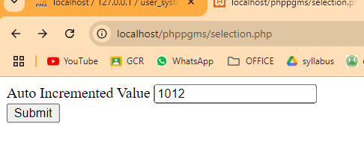
<!-- HTML form with pre-filled data -->
<form method="post" action="">
<label for="rlNo">Auto Incremented Value </label>
<input type="text" id="lastName" name="rlNo" value="<?php echo htmlspecialchars($rlno); ?>">
<br>
<input type="submit" value="Submit">
</form>

